Slide 1

Data Science Salary Trends for US Workers – 1Q2023
Rutgers Data Visualization Bootcamp – Group 3
June 2023

Slide 2



Agenda
Introduction
Data Cleaning
Data Analysis
Modeling
Predictions
Lessons Learned

Slide 3




Introduction
The aim of this project was to create a model and app to predict salary of data science jobs in the US based on job title,
Data source:
Hypothesis or questions this analysis can visualize or questions the model can answer

Slide 4

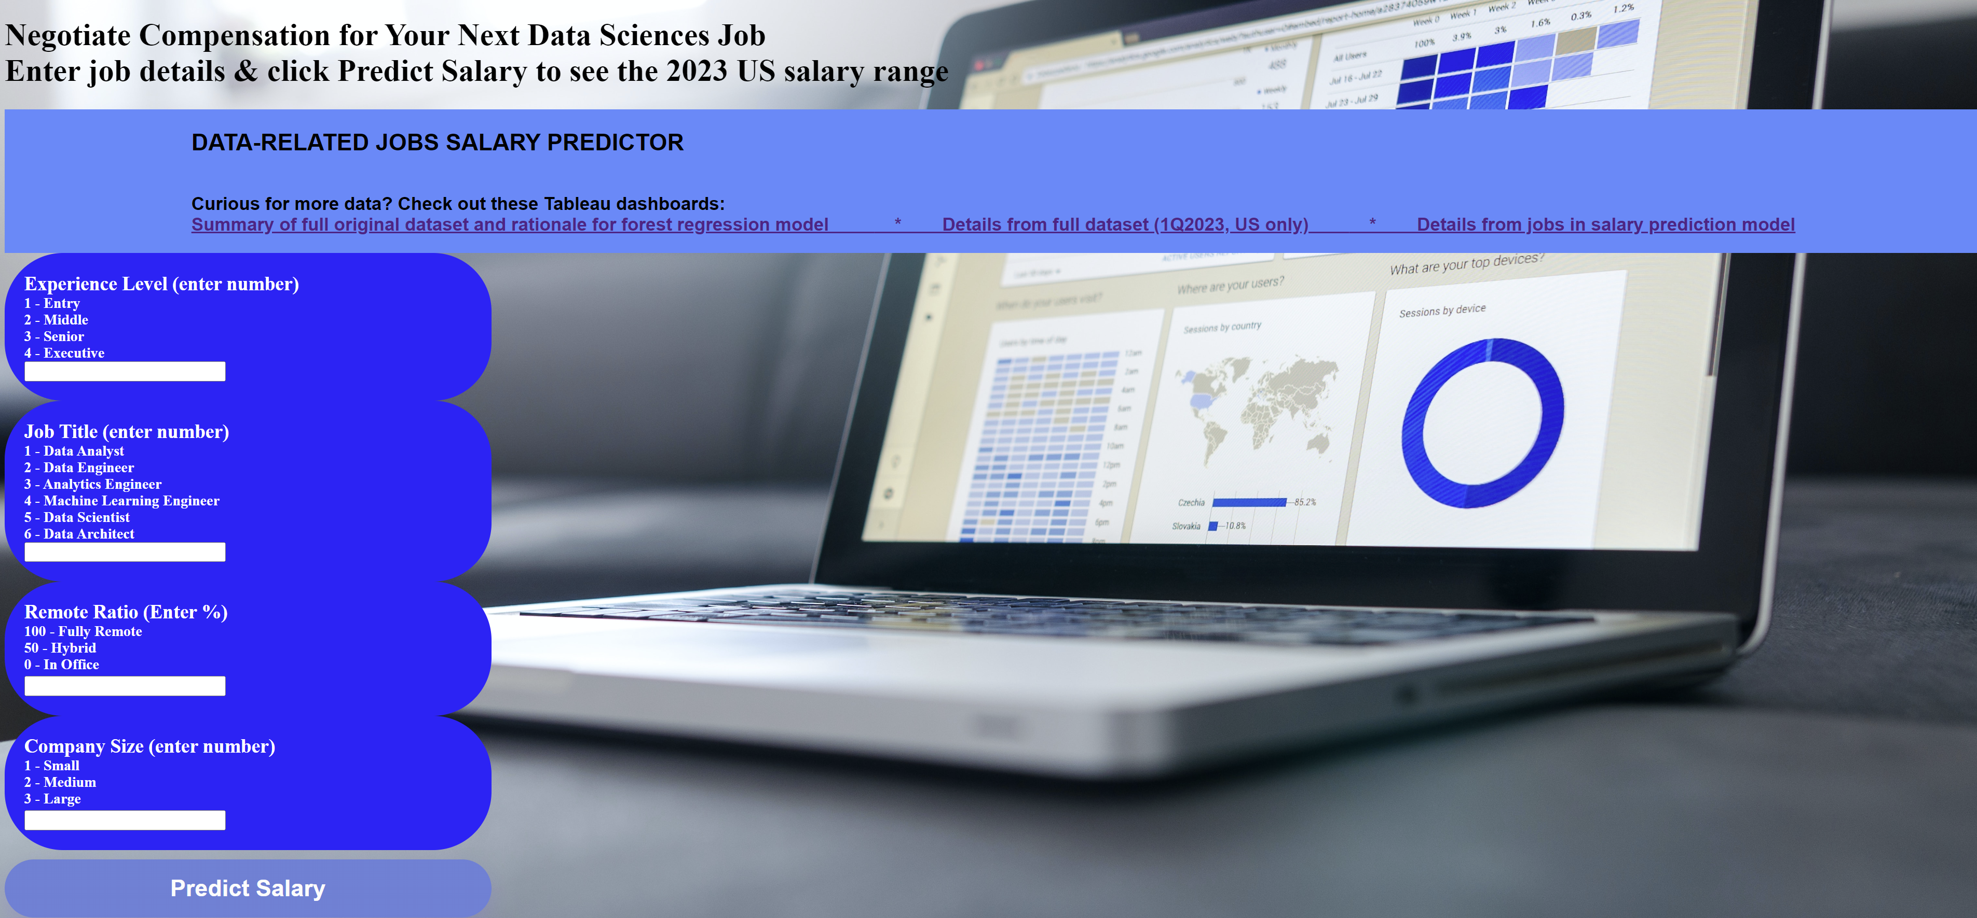

Slide 5





Tools Used
 | Pandas | Path | Tableau | Scikit-learn | Flask | pickle | HTML | CSS
Cleaning | X | X | X
Analysis | X | X | X
Visualization |  |  | X |  |  |  | X
Modeling | X | X |  | X
Website design |  |  |  |  | X | X | X | X
Predictions |  |  |  | X | X | X | X

Slide 6





Team
Calogera McCormick
Sana Ayubzai
Minta Burke
Aaron Lilleoien
Tawn Scotton
Select Dataset
Data Cleaning
Data Analysis
Data Modeling
Data Predictions
Project Manager
Data Scientist
Data Engineer
Data Architect
Data Analyst

Slide 7

Data Cleaning
Used Tableau to visualize full dataset. Identified roles with highest frequency and features (eg, ex-US countries, contractor job type) with low frequency.
Dropped null values and null values.
Identified columns that did not add value & marked for deletion.
Used Python to refine dataset.
Grouped data - combined all job titles into 7 grouped titles (ie, Data Analyst, Data Architect, Data Engineer, Data Manager, Data Scientist, Developer, Other)
Binned data – 9 bins of salary data from from <50K to >400K USD
Codified features that were categorical data (eg, experience level updated to 1, 2, 3, 4).

Slide 8
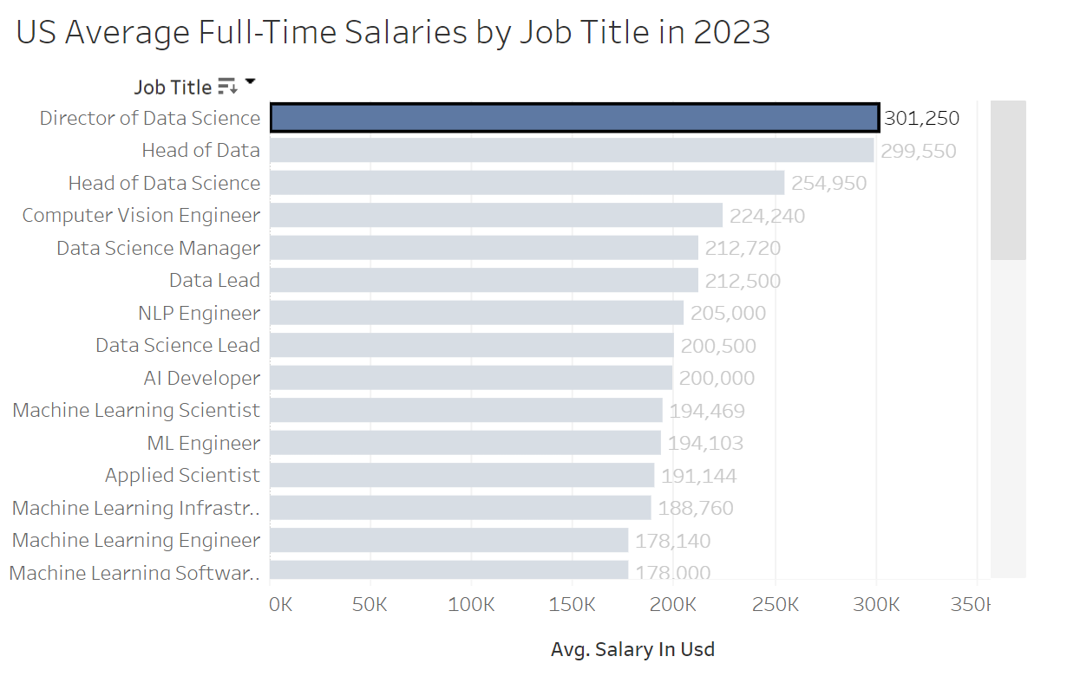
Data Cleaning

Slide 10
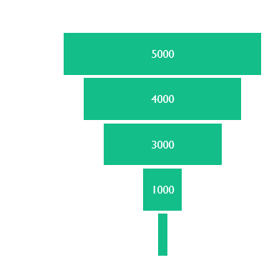
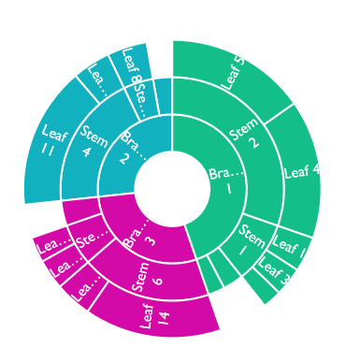
Show graphs like Tableau dashboard

Slide 11
Content
Subtitle
Subtitle
Add text, images, art, and videos.
Add transitions, animations, and motion.
Save to OneDrive, to get to your presentations from your computer, tablet, or phone.
Open the Design Ideas pane for instant slide makeovers.
When we have design ideas, we’ll show them to you right there.

Slide 12
Data Analysis

Slide 13
Content 2
Subtitle
subtitle
subtitle
Add text, images, art, and videos.
Add transitions, animations, and motion.
Save to OneDrive, to get to your presentations from your computer, tablet, or phone.
Open the Design Ideas pane for instant slide makeovers.
When we have design ideas, we’ll show them to you right there.
Add text, images, art, and videos.
Add transitions, animations, and motion.
Save to OneDrive, to get to your presentations from your computer, tablet, or phone.
Open the Design Ideas pane for instant slide makeovers.
When we have design ideas, we’ll show them to you right there.
Add text, images, art, and videos.
Add transitions, animations, and motion.
Save to OneDrive, to get to your presentations from your computer, tablet, or phone.
Open the Design Ideas pane for instant slide makeovers.
When we have design ideas, we’ll show them to you right there.

Slide 14
Data Modeling
Gathered and prepared the data: Imported the refined csv from the data cleaning.
Split the data into training and test data sets.
Identified the features (job category, experience level, remote ratio, company size) and target variable (ie, salary in USD).
Trained and tested a forest regression model.
Evaluated model and finetuned the model.

Slide 15
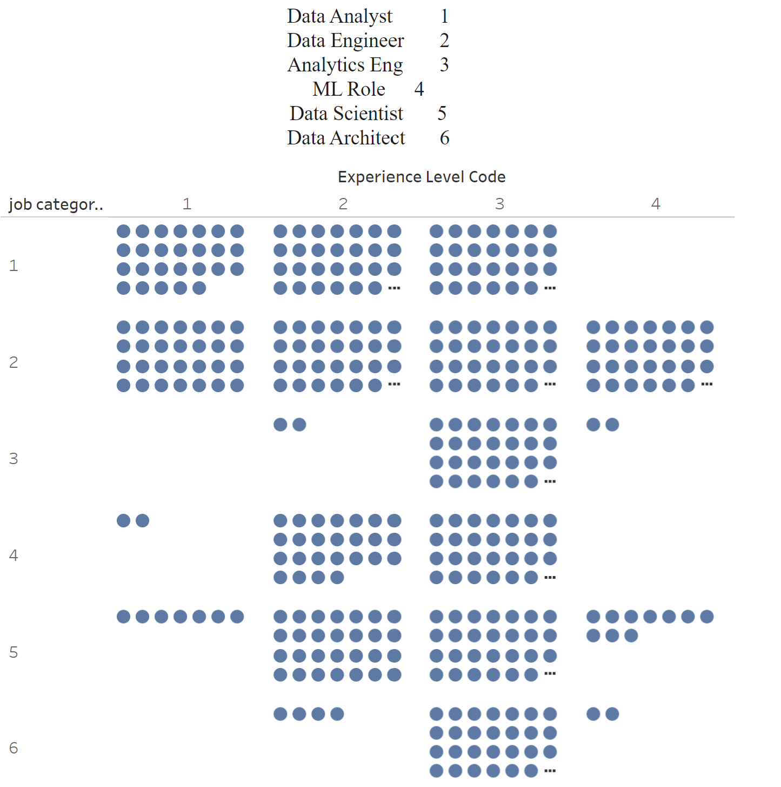
Content 2
Subtitle
subtitle

Slide 16
Data Predictions
With PowerPoint, you can create presentations and share your work with others, wherever they are. Type the text you want here to get started. You can also add images, art, and videos on this template. Save to OneDrive and access your presentations from your computer, tablet, or phone.

Slide 17
Content 2
Subtitle
subtitle
subtitle
Add text, images, art, and videos.
Add transitions, animations, and motion.
Save to OneDrive, to get to your presentations from your computer, tablet, or phone.
Open the Design Ideas pane for instant slide makeovers.
When we have design ideas, we’ll show them to you right there.
Add text, images, art, and videos.
Add transitions, animations, and motion.
Save to OneDrive, to get to your presentations from your computer, tablet, or phone.
Open the Design Ideas pane for instant slide makeovers.
When we have design ideas, we’ll show them to you right there.
Add text, images, art, and videos.
Add transitions, animations, and motion.
Save to OneDrive, to get to your presentations from your computer, tablet, or phone.
Open the Design Ideas pane for instant slide makeovers.
When we have design ideas, we’ll show them to you right there.

Slide 18
Summary
With PowerPoint, you can create presentations and share your work with others, wherever they are. Type the text you want here to get started. You can also add images, art, and videos on this template. Save to OneDrive and access your presentations from your computer, tablet, or phone.

Slide 19
Lessons Learned
A few lessons learned here
And here
Refine scope of our questions based on time constraints. Model built to predict salary based on inputs. We did not complete the additional models to predict job title or experience level based on salary.

Slide 20

Ready to negotiate salary for your new data science position… this app is here to help. Know your worth. You are your best advocate.

Slide 21
Data Sources
Original dataset: https://www.kaggle.com/datasets/arnabchaki/data-science-salaries-2023,

Slide 22


Thank You
Presenter name
Email address
Github address

